Slide 1
PowerPointLabs Test Cases
General instructions:
DO NOT SAVE these slides after testing. Keep this file in its original form.
If your result is different from the expected output, please submit a bug report (attach slides/screenshots as necessary).

Slide 2
Effects Lab

Slide 3
Effects Lab
Ref to Functional Test

Slide 4
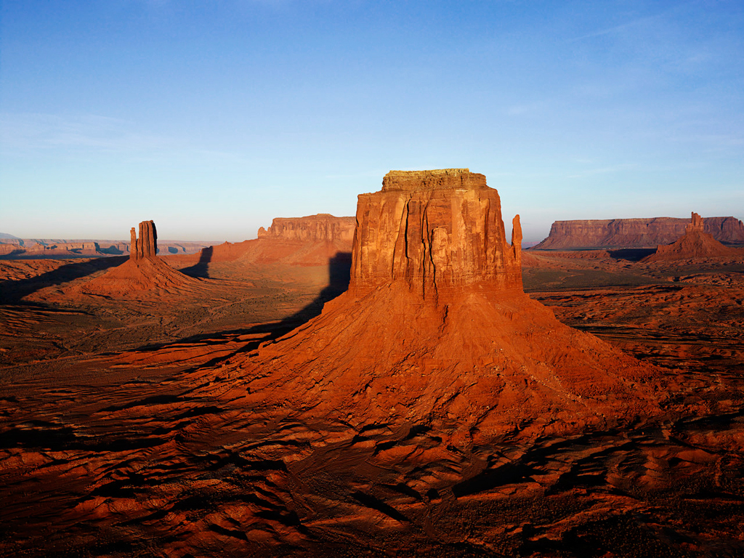
Back

Slide 5

Back
Notes:
Expected: make transparent

Slide 6
Back

Slide 7
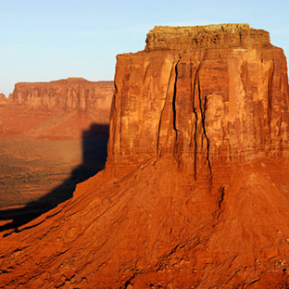
Back
Notes:
Expected: magnifying glass

Slide 8
Back

Slide 9
Back
Notes:
Expected: blur1

Slide 10

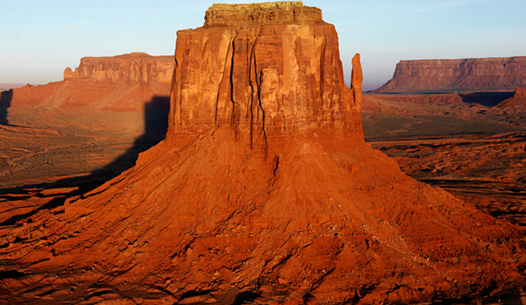
Notes:
Expected: blur2

Slide 11
Back

Slide 12
Back
Notes:
Expected: gray scale1

Slide 13
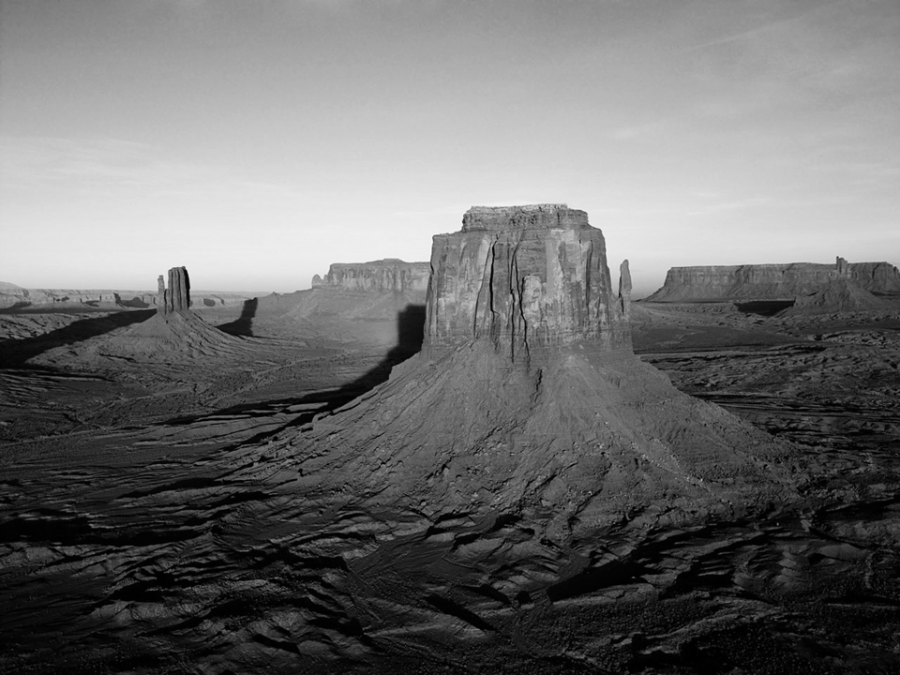
Notes:
Expected: gray scale2

Slide 14
Back
TEXT IN SHAPE

Slide 15
Back
TEXT IN SHAPE

Slide 16
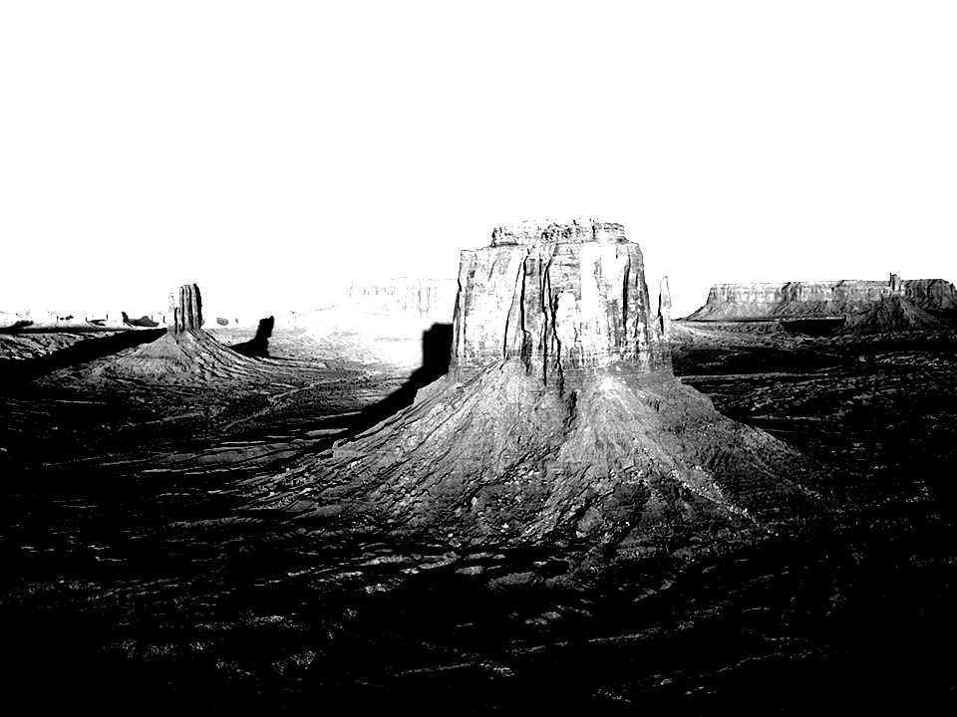
TEXT IN SHAPE

Slide 17
Back

Slide 18
Back
Notes:
Expected: Gotham1

Slide 19
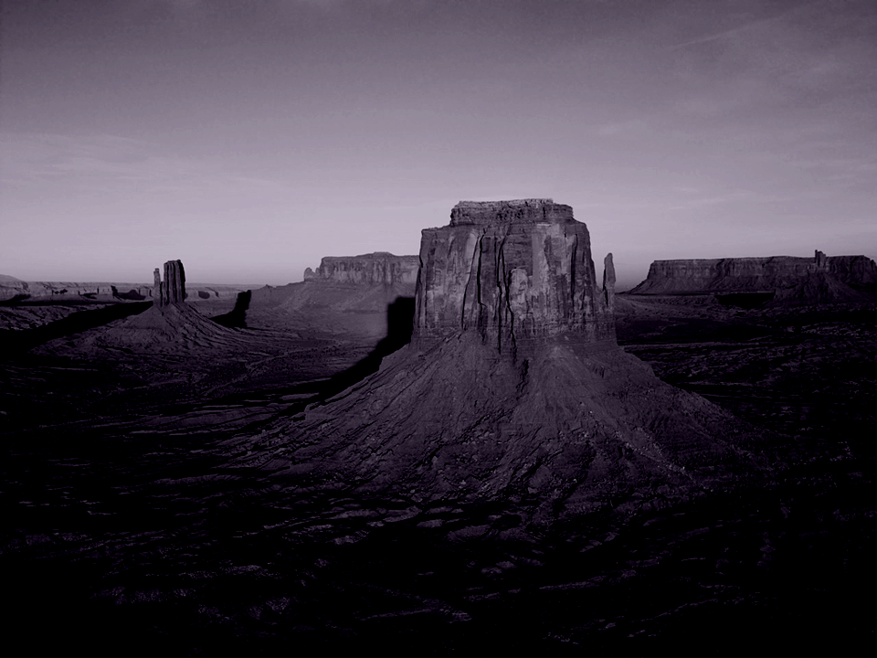
Notes:
Expected: Gotham2

Slide 20
Back

Slide 21
Back
Notes:
Expected: sepia1

Slide 22
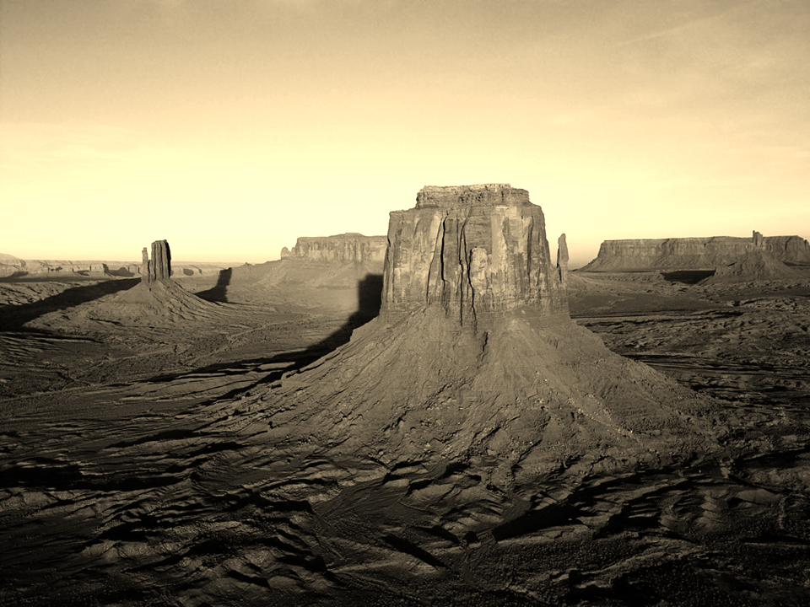
Notes:
Expected: sepia2

Slide 23
Back
TEXT IN SHAPE

Slide 24
Back
TEXT IN SHAPE

Slide 25

TEXT IN SHAPE

Slide 26
Back
TEXT IN SHAPE

Slide 27
Back
TEXT IN SHAPE

Slide 28

TEXT IN SHAPE

Slide 29
Back
TEXT IN SHAPE

Slide 30

Back
TEXT IN SHAPE

Slide 31
Back
TEXT IN
TEXT BOX

Slide 32

Back
TEXT IN
TEXT BOX

